Slide 1
IT Application II Related paper survey
2021. 05. 12
Presentation by Han, Yejin
hyj0225@dankook.ac.kr

Slide 2
Introduction
User-space file system
Survey paper (1,2,3)
4. Future work

Slide 3
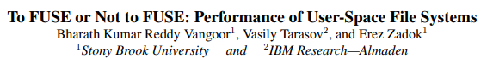
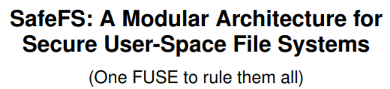
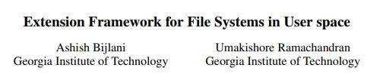
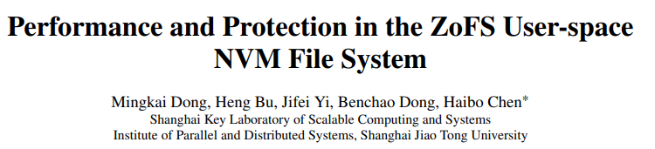
1. Introduction
2017 USENIX FAST
2017 ACM International Systems and Storage Conference
2019 ACM Transactions on Storage
2019 ACM SOSP
2019 USENIX ATC

Slide 4
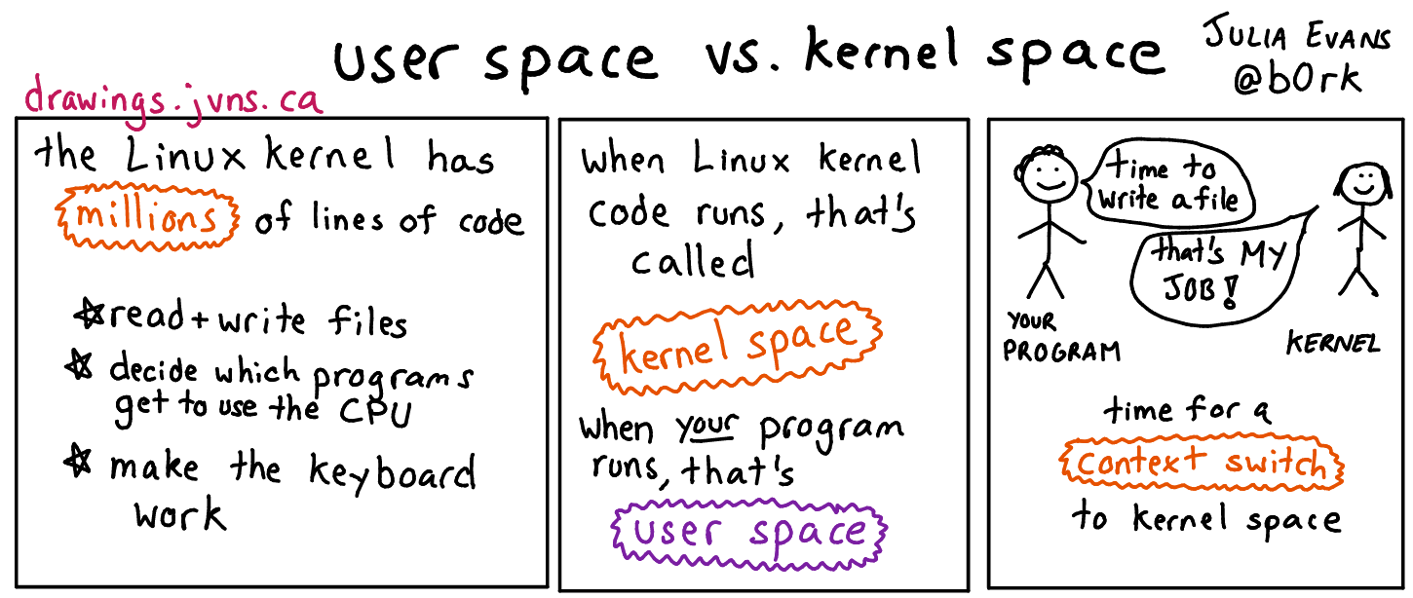
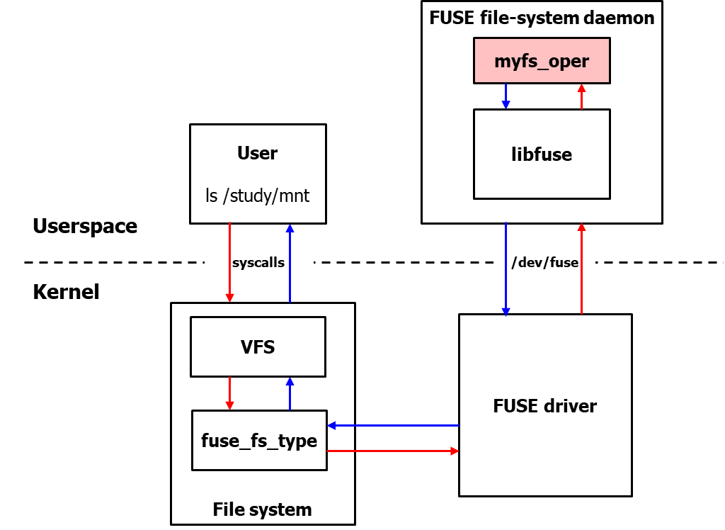
2. User-space file system
User File systems
In-Kernel
Low performance
User-level bug do not crash
the whole system
Can use many debugging tools and libraries
Ease of development
High performance
Kernel-level bug can crash
the whole system
Limited set of tools and facilities
Development is challenging
Notes:
Low performance(high overhead of passing requests between kernel-user space daemon)
User-level bug do not crash the whole system and do not require a lengthy reboot but rather generate a useful core memory dump
Kernel-> complexity

Slide 5
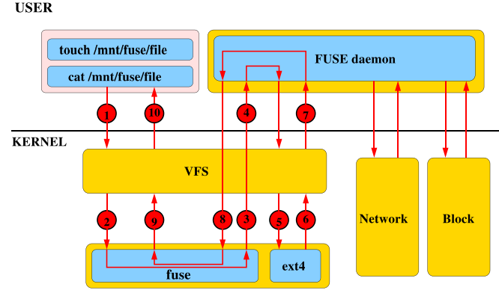
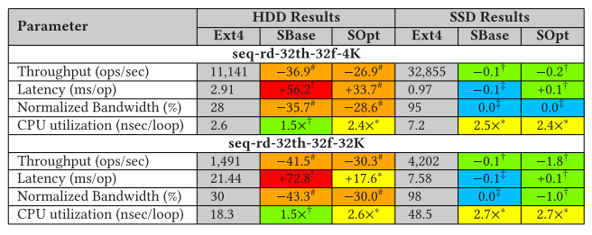
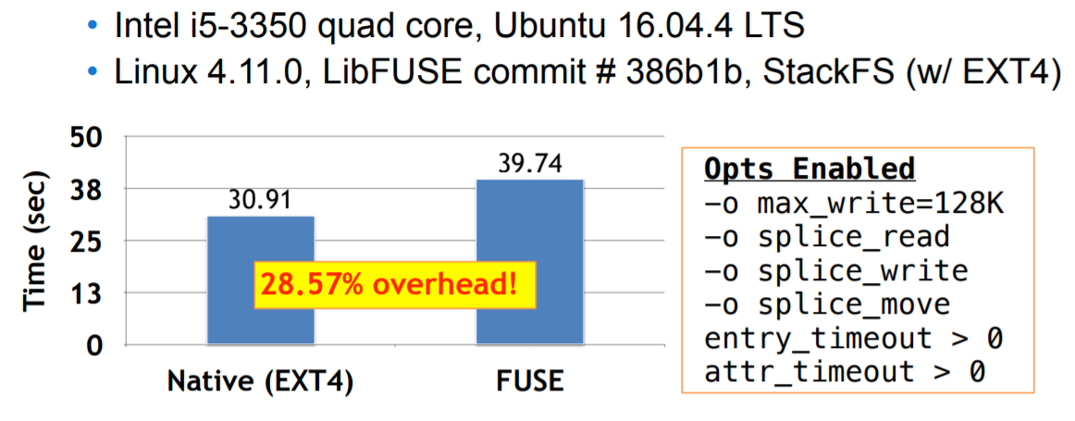
3. Survey paper -1
Performance and Resource Utilization of FUSE User-Space File Systems
(ACM Transactions on Storage Vol. 15, No. 2, Article 15.Publication date: May 2019)
stackfs

Slide 6

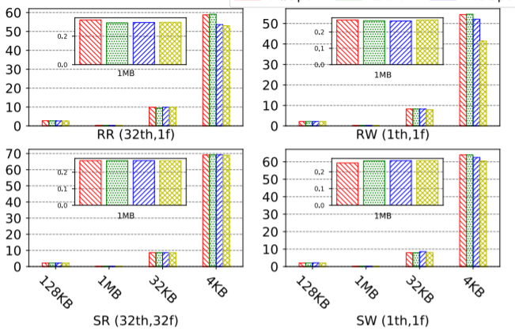
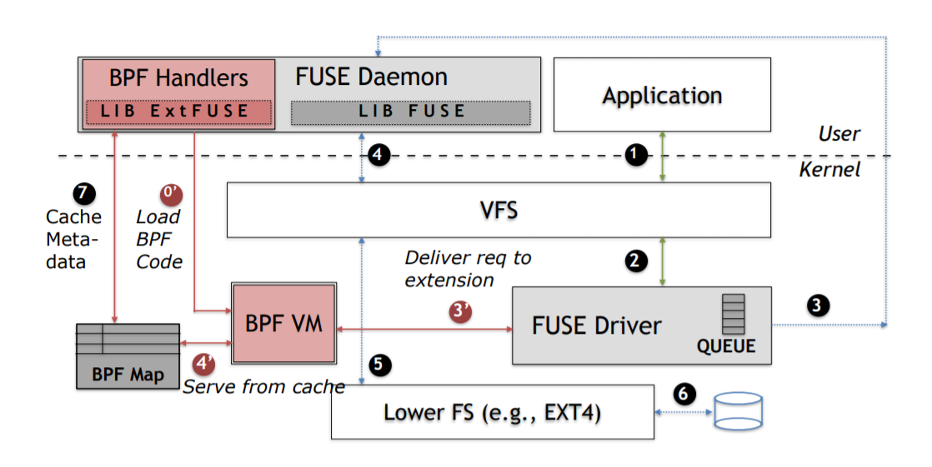
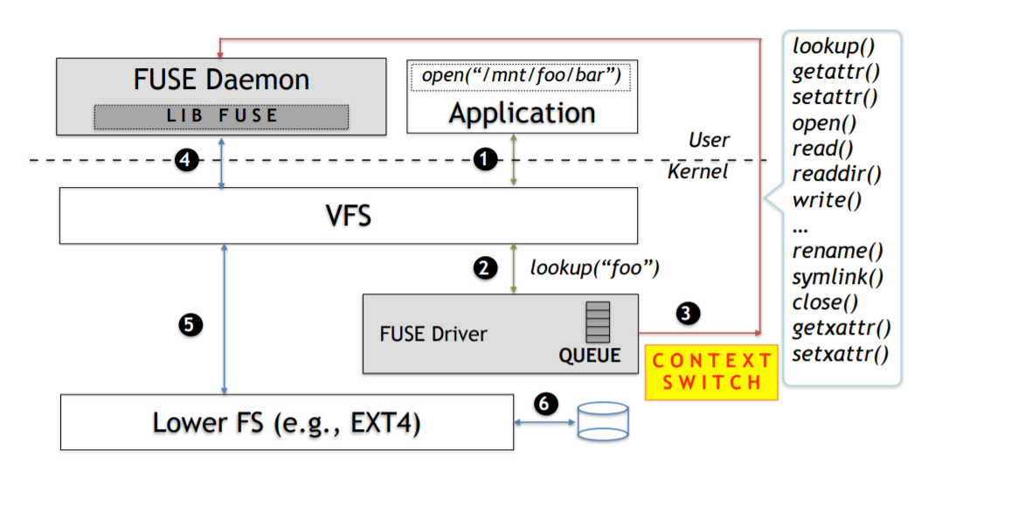
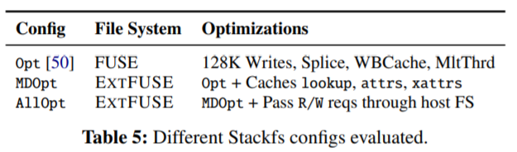
3. Survey paper - 2
Extension Framework for File Systems in User space
(2019 USENIX Annual Technical Conference)
ExtFUSE
FUSE
Leveraging eBPF
Context switching
Data copying

Slide 7
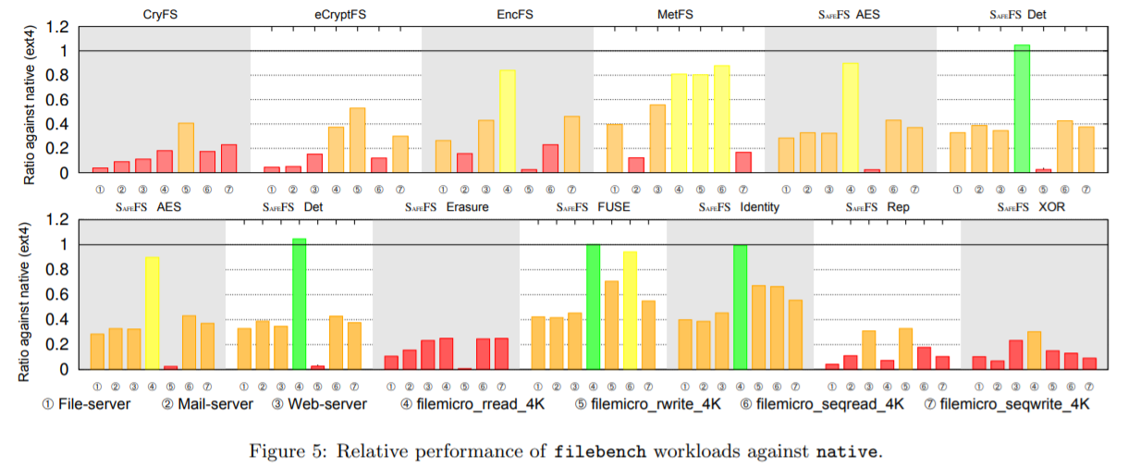
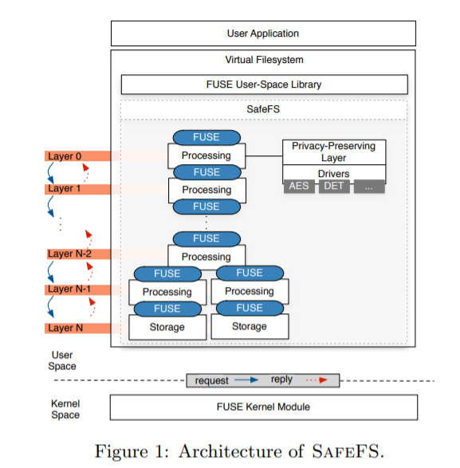
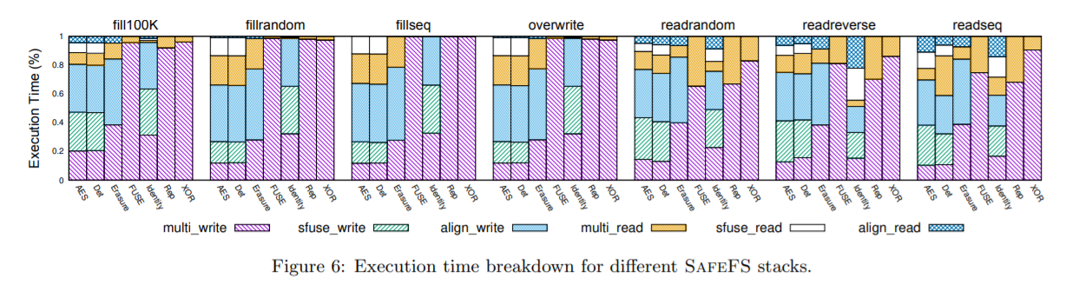
3. Survey paper - 3
SafeFS: a modular architecture for secure user-space file systems: one FUSE to rule them all
(SYSTOR ’17: Proceedings of the 10th ACM International Systems and Storage Conference)
SAFEFS

Slide 8
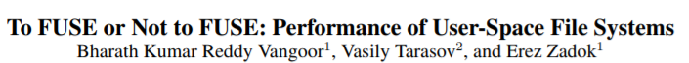
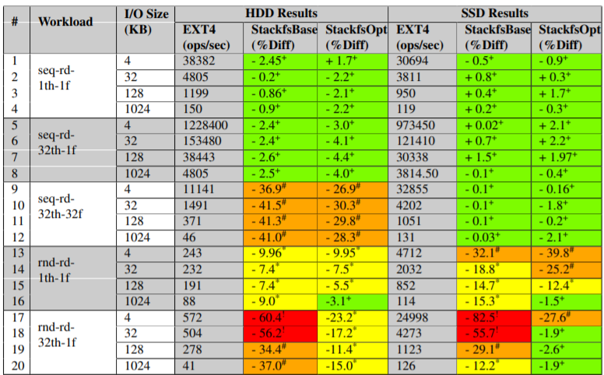
4. Future work
advanced experimental environment
CPU | Intel Xeon CPU E5530 4 core 2.40GHz
Memory | 4 GB RAM
OS | 64-bit Linux 3.14
Filesystem | Ext4 / StackfsBase / StackfsOpt
Device | SSD 200GB Intel X25-M SSD HDD 146GB Seagate Savvio 15K.2, 15KRPM
CPU | Intel® Core™ i5-4440 CPU 4 core 3.10GHz
Memory | 32 GB RAM
OS | 64-bit Linux 5.7.7
Filesystem | Ext4 / StackfsBase / StackfsOpt
Device | SSD 256GB Samsung SSD 850 HDD 500GB Western Digital WD BLUE, 72KRPM
?

Slide 9
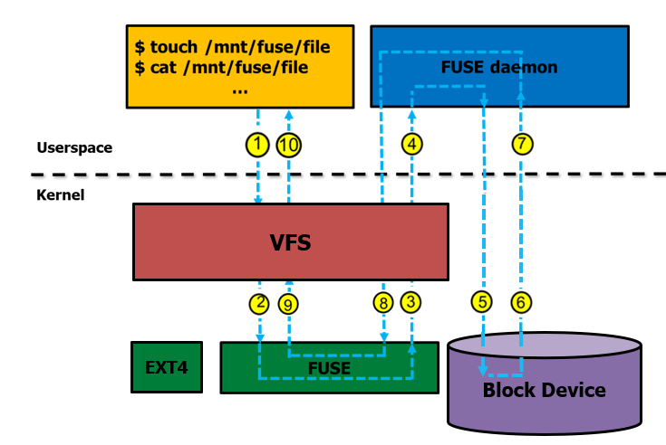
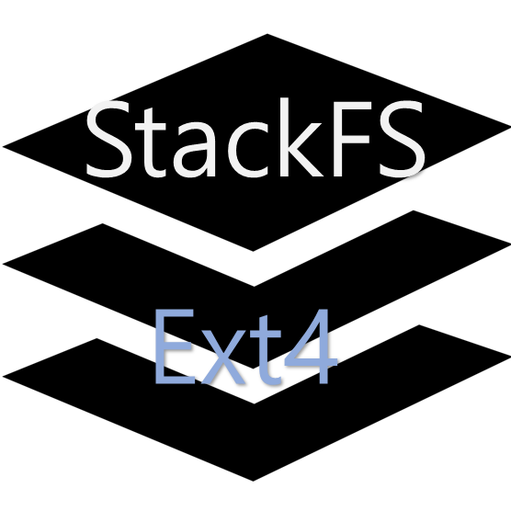
4. Future work
Directly access to SSD using FUSE
FUSE optimizations
Splicing support
Multi-threaded daemon
Write-back cache
Direct

Slide 10
Thank You!
2021. 05. 12
Presentation by Han, Yejin
hyj0225@dankook.ac.kr
Notes:
Let me begin my presentation.
Today I will give a presentation on “Fully Automatic Stream Management for Multi-Streamed SSDs Using Program Contexts”

